Slide 1
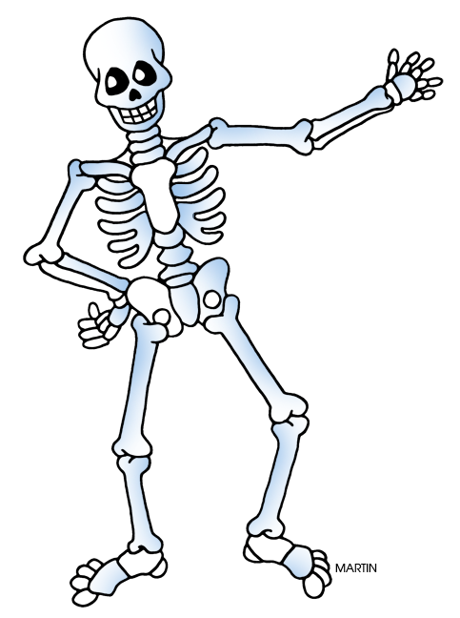
The Skeletal System
Joy Hardy and Jess Short

Slide 2
What is the Skeletal System?
The skeletal system is made up of all 206 bones in our body.
The skeletal system helps to support the body, protect tissues and organs, and allow movement.

Slide 3
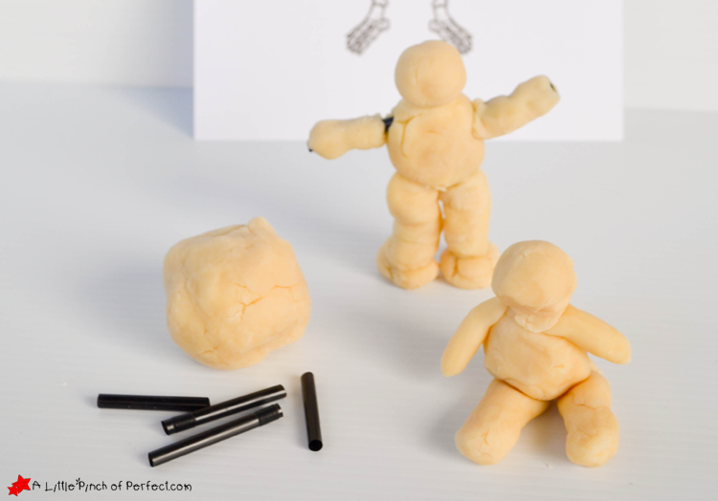
Support for the Body Activity
Goal/objective of activity:
Teach kids the role the skeletal system has in supporting the body.
Materials:
Coffee straws or toothpicks, play-doh, scissors

Slide 4
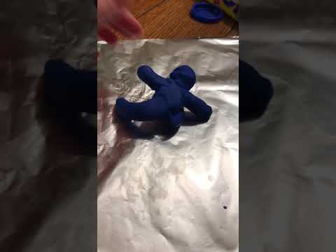
Play-doh Man #1
Construct Man #1 by rolling the play-doh to make a head, legs, and arms. Attach the body by simply pushing the play-doh together.
When you try to make Man #1, you can tell there is nothing to support him. He is unable to stand, sit, or move without falling and coming apart.

Slide 5
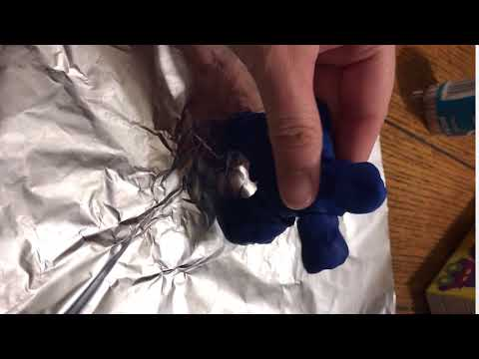
Play-doh Man #2
Make Man #2 using cut up straws or toothpicks. Construct Man #2 by placing the straws or toothpicks inside the play-doh legs and arms.
The straws or toothpicks give the man support just like our bones do. With the support of “bones” he can stand and sit.

Slide 6
Outcome
Through this activity children will be able to see that the skeletal system plays an important role in supporting the body.

